Slide 1
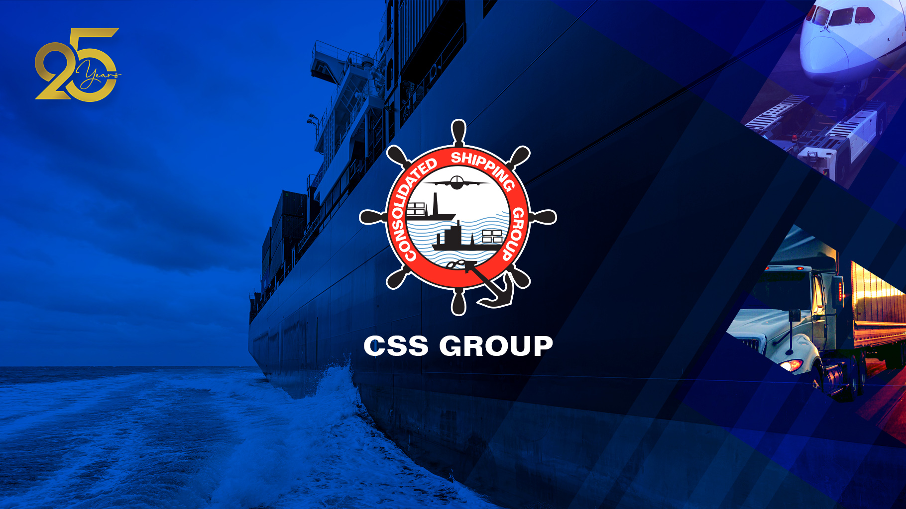
OUR COMPANY
OUR REACH
CONTACT US

Slide 2



OUR COMPANY
OUR GROUP
SERVICES
BACK

Slide 3
OUR GROUP
Consolidated Shipping Services Group L.L.C. is one of the leading integrated freight forwarding solutions providers, with 25 years of service in the industry. CSS Group, a renowned name in Freight Forwarding and NVOCC in the region it operates. Headquartered in Dubai, United Arab Emirates, spearheaded by its Founder and Chairman, T. S. Kaladharan.
Through its corporate diversity and willingness to keep learning and relearning, the company has earned its collective experience within the industry. With a team consisting of over 750 experienced and dedicated professionals across 20 offices, CSS can meet a client’s freight forwarding requirements - be it by sea, land, or air.
The CSS Group adapts itself to the industry's latest trends, offering efficient and feasible solutions to its clients and associates.
BACK

Slide 4
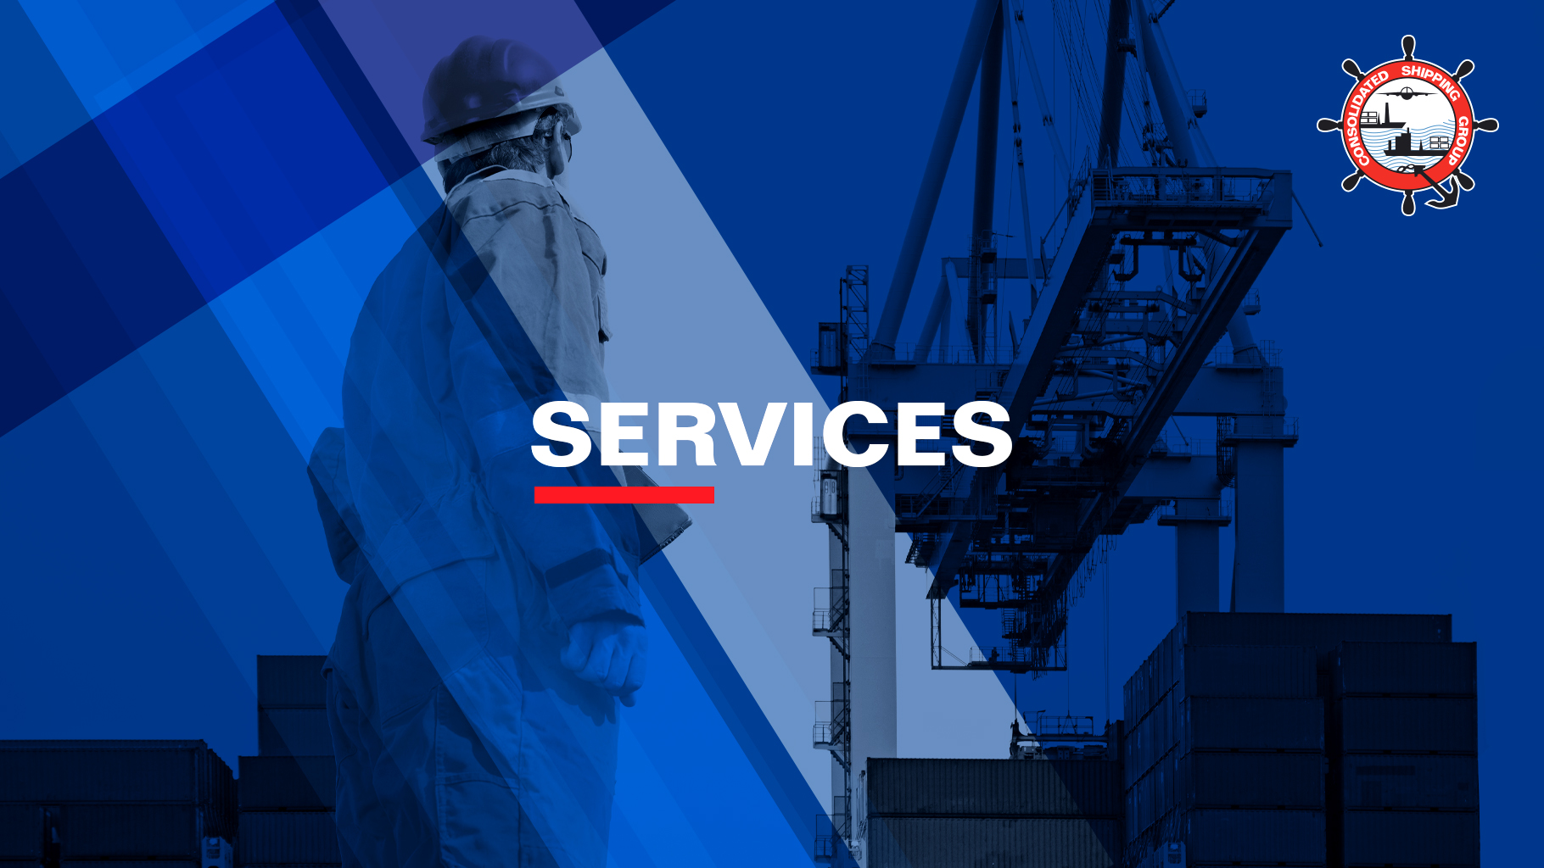












NVOCC / OCEAN FREIGHT
MANAGEMENT
EXHIBITION & EVENT
LOGISTICS
AIR FREIGHT
MANAGEMENT
YACHT & MARINE
LOGISTICS
LAND TRANSPORTATION
MANAGEMENT
INDUSTRIAL PACKING,
CRATING & LASHING
MULTIMODAL
OPERATIONS
CONTAINER FREIGHT
STATION
PROJECTS, OIL
& ENERGY
SUPPLY CHAIN
MANAGEMENT (SCM)
AUTOMOBILE
LOGISTICS
HOSPITALITY & HOTEL
LOGISTICS
BACK

Slide 5

NVOCC / OCEAN
FREIGHT MANAGEMENT
The Ocean Freight Management team of Consolidated Shipping Services L.L.C handles Cargo movement from/to any global origin/destination - be it LCL or FCL.
Its fully-functional CFS and Supply Chain facilities are rated among the best in the region.
Services
LCL services across 6 continents
A leading NVOCC maintaining excellent relationships with leading carriers, ensuring competitive rates and services
Regular scheduled movements with reputed carriers, including Main Line Container Carriers
Seamless service for custom documentation and deliveries
Facility
80,000 sq. ft. Container Freight Station in the heart of the Jebel Ali Free Zone
100,000 sq. ft. state-of-the-art, Open Yard insured facility
4,535 pallet positions, with 10,000 CBM capacity
12 custom built dock levelers with a load capacity of up to 10 tons, providing easy access to trailers, complying with safety standards & efficient loading/unloading processes
‘Health Safety Environment’ (HSE), with the latest fire protection systems
12,000 sq.ft modern administrative set up
Managed and operated by CSS Group staff and equipment
All operations are monitored by CCTV
BACK

Slide 6

AIR FREIGHT
MANAGEMENT
The Air Freight division offers innovative Air Cargo services through its home base in Dubai International Airport Cargo Gateway (Dubai Cargo Village). The Air Freight team is rated as a total logistic solutions provider, and a trusted partner for Air Cargo Management.
Our expertise of import and export requirements, customs regulations, licenses & consular documentation can help you achieve optimum results in Air Freight operations.
Services
ATA capabilities with Dubai International Airport (T3, FG5) and DWC
Air Freight (Export / Import Consolidation)
Multimodal Operations (Sea/Air, Sea/Land Management)
Project Cargo handling
Perishable Goods Cargo handling
Marine & Ship Spares movement
Aircraft Chartering
Clearing, Forwarding & Door-to-door service
Customs clearance and delivery
Supply Chain and Logistics Management
Cargo General Sales Agent
Acceptance and Handling of Dangerous Goods
Facility
Bonded warehouse facility in Dubai Cargo Village and Jebel Ali Free Zone, UAE
GCAA and IATA approved DG Agent
Partnerships with an exclusive network of agents worldwide
ISO 9001 Certified
Online customs clearance and freight booking facility
BACK

Slide 7
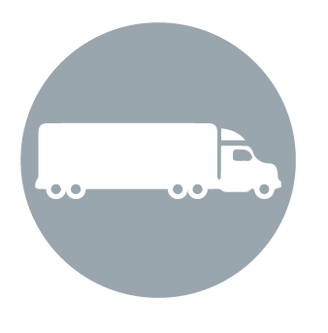
LAND TRANSPORTATION
MANAGEMENT
Land Transportation department has been providing regular full loads and services within the GCC and Levant countries. It maintains flexible and tailor-made road services to meet customer needs.
The commitment and dedication to our customers, carriers, drivers, agents, and employees are what separates the CSS Group’s Land Transportation department from other trucking companies and service providers.
Services
Container transportation
Land transportation to GCC countries and Levant (LTL and FTL)
Surveys on demand & Break bulk movements
Special and heavy equipment movements
Flexible arrangements of cranes and forklifts
Providing riggers, port operations & border clearance
Capable of handling perishable and dangerous goods cargo
Tailor made solutions
Facility
CSS Group fleet of trucks, trailers, and pickups
State-of-the-art marshalling facilities
Experienced professionals
BACK

Slide 8

INDUSTRIAL PACKING,
CRATING & LASHING
The CSS Group provides Industrial Packing, Crating & Lashing logistical solutions within the UAE and GCC. We specialize in crating fragile items (glass, mechanical items etc.), sensitive cargo (laboratory equipment, calibration equipment’s etc.) and heavy cargo (generators, turbines etc.)
The commitment and dedication to our customers, carriers, drivers, agents, and employees are what separates the CSS Group’s Land Transportation department from other trucking companies and service providers.
Services
Industrial Crating
Skilled carpenters for fabrication of industrial crates
Top quality materials for packing
Heat treatments with ISPM certificates
All personnel use standard PPE and adhere to Safety Standards
Industrial Lashing
Undertake all types of lashing and securing jobs
Well-trained, skilled riggers for lashing
Over-dimension and overweight cargo lashing
BACK

Slide 9

MULTIMODAL OPERATIONS
(SEA-AIR, SEA-LAND)
CSS offers integrated freight forwarding and logistics solutions to a great number of clients using multimodal operations.
Services
Local and International services
Dedicated clearing division for air, sea and land services
Capable of handling perishable & Dangerous Goods cargo
Door-to-Door services through CSS’ fleet of vehicles, inclusive of border clearances
BACK

Slide 10

CONTAINER FREIGHT
STATION
The CSS Group’s Container Freight Station has become a landmark success, located in Jebel Ali, Bahrain and Oman.
Services
State-of-the-art, fully-racked insured warehouse facility
Custom built dock levelers to facilitate easy access for trailers, for safe and efficient loading/unloading of cargo
‘Health Safety Environment’ (HSE), with the latest fire protection systems
Modern administrative set up
Managed and operated by the CSS staff and equipment
All operations are monitored by CCTV
BACK

Slide 11

PROJECT, OIL
& ENERGY
Projects, Oil and Energy division is a proven success in the Middle East. Providing end to end solutions in project management, the company is seen as an expert in the global energy business.
We carefully study the geographical and product mix of our clients to prove the best solution while optimizing their business, saving them time and money. Our customer know they can count on us for flexible scheduling, and efficient management.
Services
Managing Every aspect of logistics during the project’s contracted period
Management defined strictly by the complexity of cargo
Monitoring purchase orders globally, with updates
Dedicated hands-on projects/contract coordination
Expert on-site supervision at origin/destination or any other transit point, if required
Planning for heavy lifts & over dimensional loads via special trucks, barges, oceans vessels and aircrafts
Optimal combination of liner services and part/full charter
Detailed and accurate documentation with updated status reports
Advice on optimal cargo specifications to minimize cost and maximize safe handling
BACK

Slide 12

AUTOMOBILE
LOGISTICS
CSS Groups’s Automobile Logistics division has show remarkable progress through several major auto movements. From ‘auto racks’ that allow for effective and environmentally friendly loading of vehicles in shipping containers, to specialized handling of high-end vehicles door-to-door, the CSS Group’s division has become a trusted name in Auto Logistics in the region.
Services
Specialized racking for vehicles
Auto-recking for loading multiple vehicles in containers
Experienced in handling luxury & Sports cars
Mass storage facilities
Technical services on request
In house documentation and clearance facilities
Door to door services
Facility
Extensive storage facility in UAE
Exceptionally strong world-wide network
Operations managed by CSS-designed technology
BACK

Slide 13

EXHIBITION & EVENTS
LOGISTICS
This dedicated division in the CSS Group specializes in logistics involving events, exhibitions, fine art logistics, trade shows and motorsports, providing end-to-end logistical solutions locally and internationally.
CSS Group’s Exhibition & Event Logistics coordinates with a client’s counterparts or principals, performs export and import or export customs formalities, pre-storage of materials and timely delivery to the stage site. The team provides unpacking and repacking services, labor assistance and delivery back to the client’s warehouse or the next destination of the exhibition.
The team also support exhibitors in the design and exhibition stands according to site infrastructure requirements.
Services
Turnkey solutions
Pre and post exhibition movements
Local and international logistics
Specialized in handling high-value cargo and fine arts
All documentation work managed for the movement of cargo
Assistance provided in designing and installing booths
BACK

Slide 14

YACHT & MARINE
LOGISTICS
The CSS Group, a world leader in the provision of marine logistics, offers global boat transportation and freight forwarding via air, road, rail and sea from a worldwide network of offices and exclusive agency partnerships.
The Yacht & Marine Logistics division is the preferred shipper for leading boat builders in the GCC and around the world.
Strategically headquartered in Dubai, UAE the CSS Group has operational bases in Jebel Ali Free Zone (JAFZA) and Dubai Airport Free Zone, as well as its other offices around the country to allow for the smoothest on-the-ground support.
Services
The largest and safest stock of Shipping Cradles in the industry
CSS Load Masters and Surveyors oversee all operations
The Yacht & Marine Logistics division arranges Covers and Shrink Wrapping, ensuring the boat arrives in the best condition
All shipments are handled directly through our local offices
Offering General Freight Services for Marine Spares and Equipment
BACK

Slide 15

SUPPLY CHAIN
MANAGEMENT
The Supply Chain Management facility is situated in Jebel Ali, Dubai, Abu Dhabi and Sharjah
The SCM facility includes delivering superior customer and financially viable value through synchronized management, and the flow of physical cargo and associated information, stating from the source.
Services
Re-work and modification
Picking and sorting
Barcoding labelling and scanning
Cas packed distribution
RFID secure facility
Warehousing and inventory management
Documentation & Customs clearence
Shipment track and trace
Transportation & Door delivery to end user
Customer service 24 x 7
Facility
Warehousing/distribution services provider under ambient/cool/cold chain
Facilities in Jebel Ali, Dubai, Sharjah and Abu Dhabi
Open yard facilities for open storage
Designated spaces for handling Value Added Services
Integrated software system developed in-house
Web-enable inventory management
One million sq.ft of 3PL space available for CSS Group customers across the UAE
BACK

Slide 16

HOSPITALITY & HOTEL
LOGISTICS
This division within the CSS Group recognizes the specialized and complex needs of the hospitality industry, offering an integrated approach with turn-key solutions. We understand the requirements of ever-changing project timelines, warehouse management coupled with planned installation processes and the need for maintaining high quality standards.
The specialized division’s assistance may be engaged at any phase, with support during pre-opening stages to providing post-opening logistics services.
Services
Hotel site logistical survey and operation planning
Global Freight & Transportation Management
Purchase Order Management, Transportation visibility, monitoring and reporting
Customs Clearance & Site Delivery
Temperature controlled warehousing
FF&E and OS&E pre-inspection services at the Central Warehouse
FF&E full installation services for mockups, hotel openings and refurbishing projects
Post-opening OS&E inventory management & delivery
Internet-based tracking and tracing
Full Insurance
Relocation services for employees and staff, chefs, executives and more Designated space for handling value-added services
BACK

Slide 17
LOCATIONS
OUR BRANCHES
BACK

Slide 18
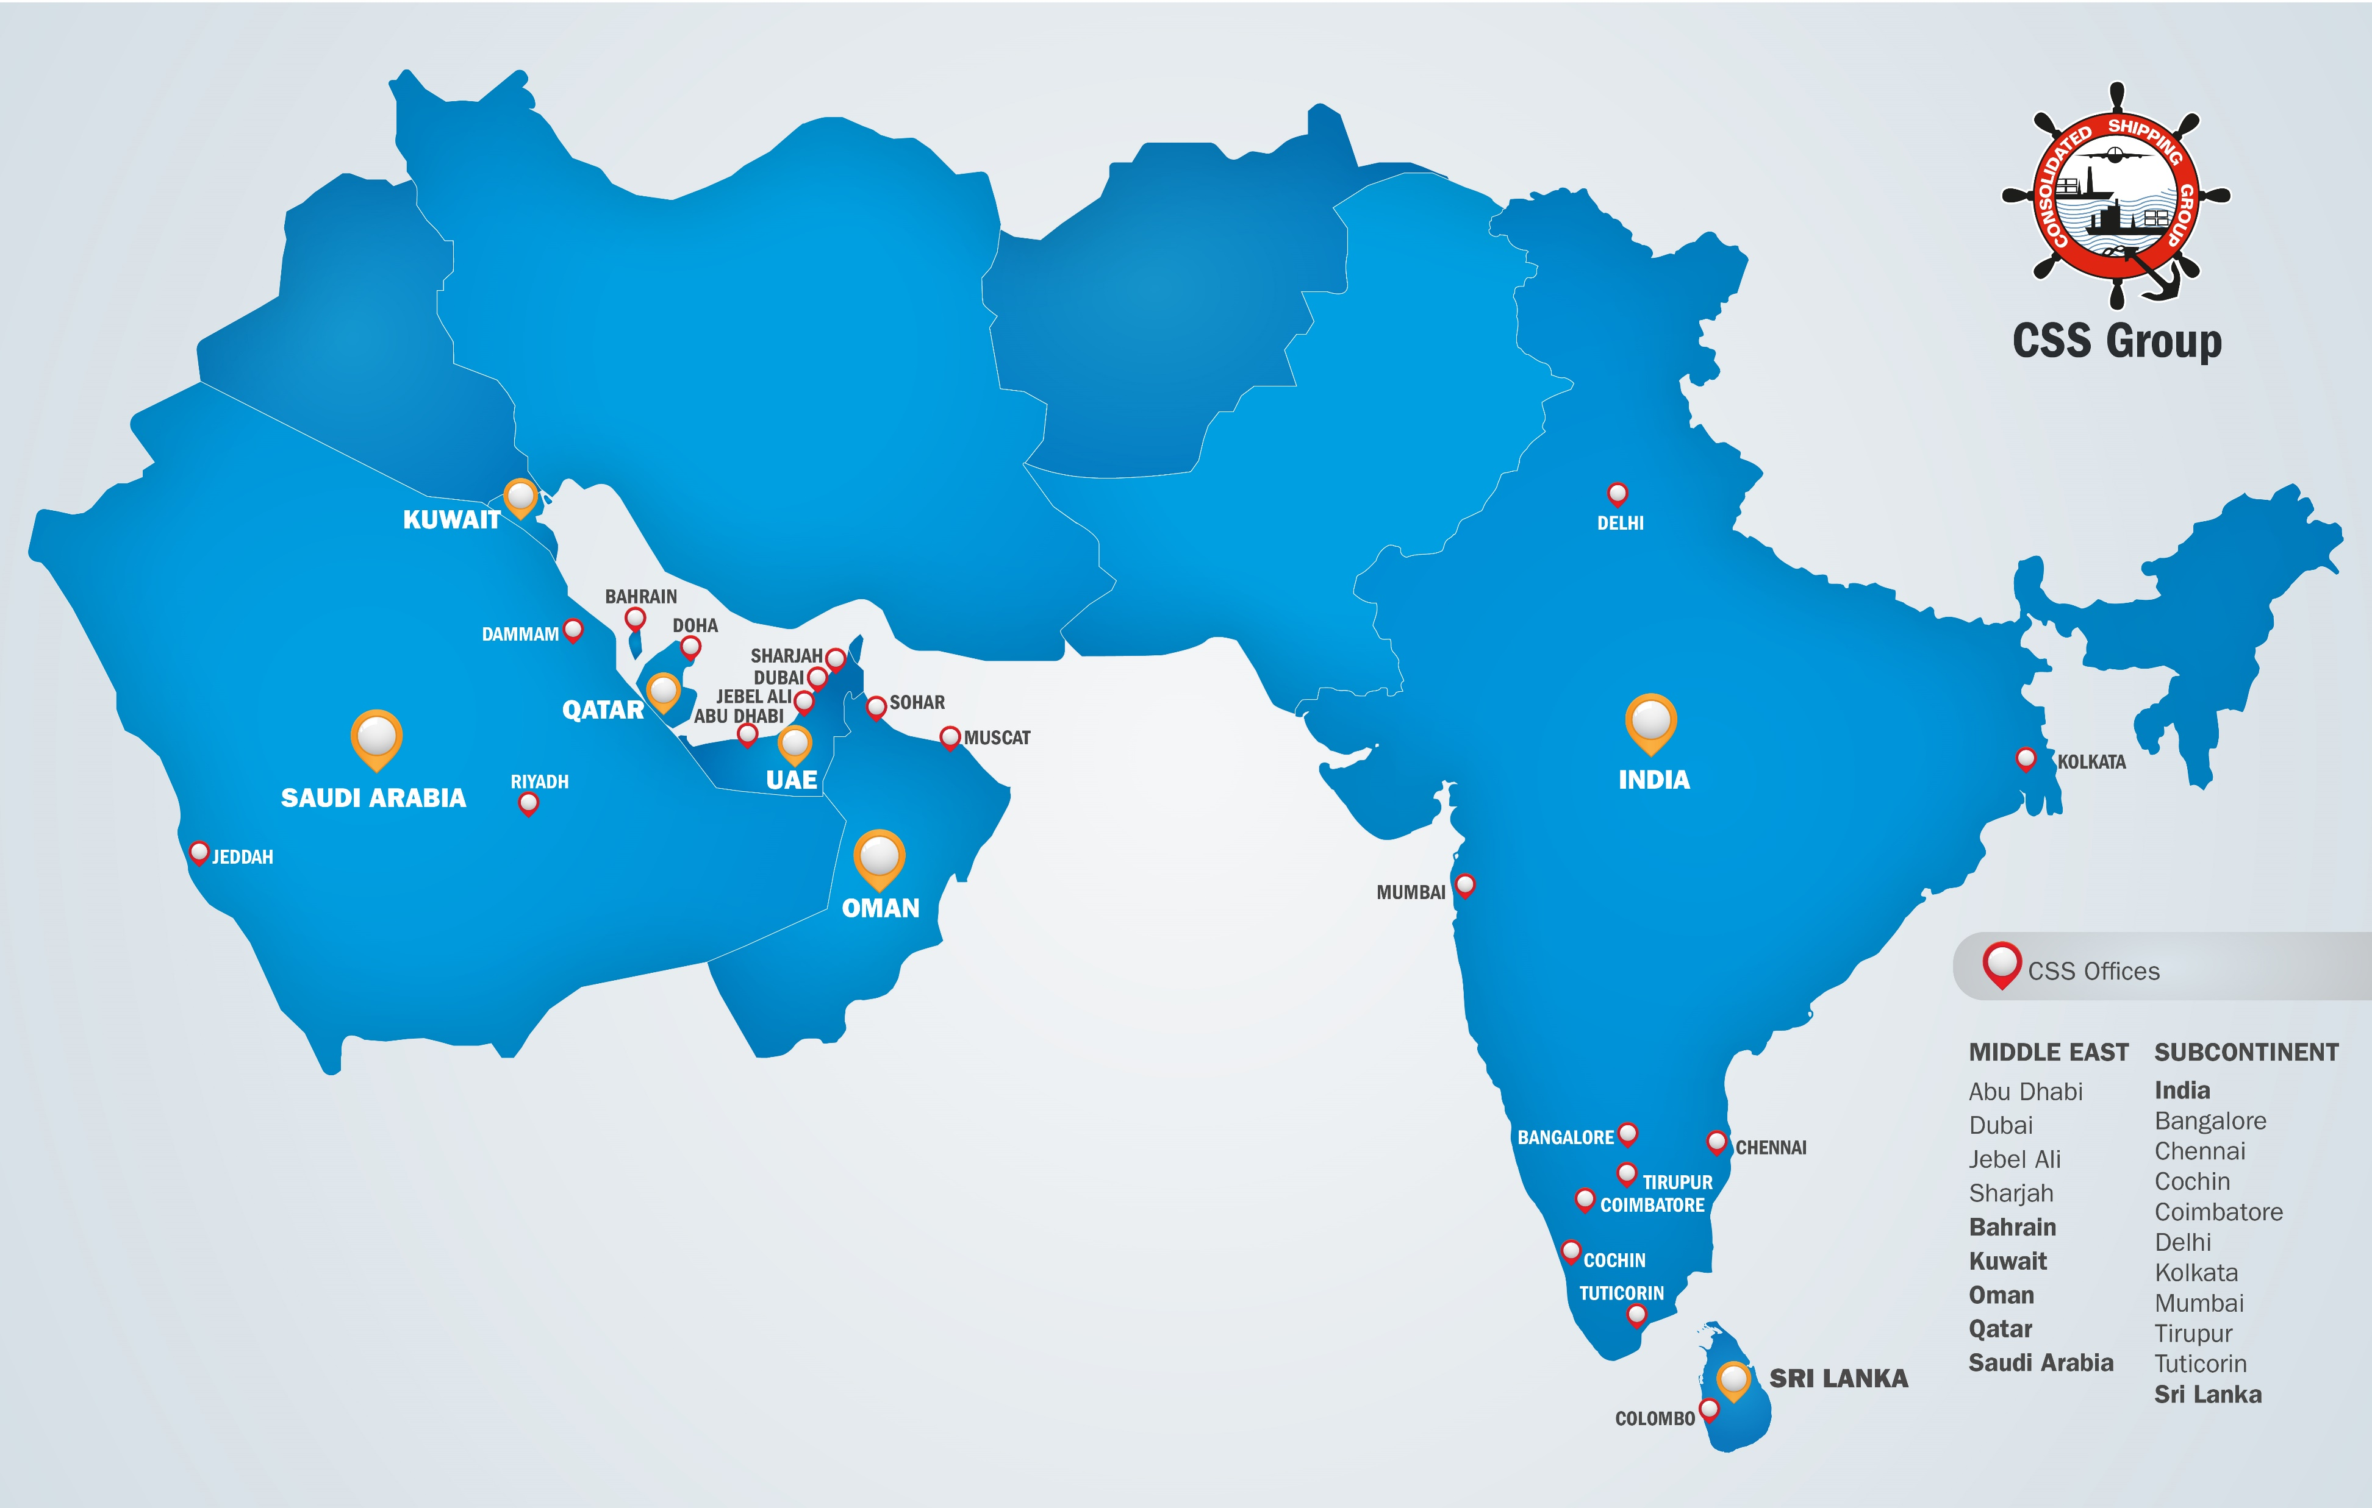
BACK

Slide 19
CSS
ABU DHABI
CSS
KINGSTON
(SHJ)
CSS
BAHRAIN
GCC – OMAN, QATAR, KUWAIT
BAHRAIN, SAUDI ARABIA
UAE – ABU DHABI, SHARJAH,
JAFZA, DUBAI CARGO VILLAGE,
AL QOUZ
SOUTH – INDIA, SRI LANKA
ASIA
CSS
KUWAIT
CSS
OMAN
CSS
QATAR
CSS
SAUDI
CSS
INDIA
CSS
SRI LANKA
BACK

Slide 20
CSS ABU DHABI
CSS Abu Dhabi has been successful in providing optimum solutions in the freight forwarding & logistics industry on a regular basis, while concentrating in niche areas of local and international land transportation, projects management, personal effects management; major contracts with multinational companies within the oil and petroleum industries are also secured.
Services
NVOCC
Ocean Freight Management
Air Freight Management
Land Transportation Management
Industrial Packing, Crating & Lashing
Multimodal Operations (Sea-Air, Sea-Land)
Container Freight Station
Projects, Oil & Energy
Automobile Logistics
Exhibition & events logistics
Yacht & Marine Logistics
Supply Chain Management (SCM)
Hospitality & Hotel Logistics
Facilities
Globally monitoring purchase orders
Hands-on project/contract coordination
On-site supervision at origin, destination or transit point,
as required
Technical planning for all heavy lifts and over dimensional load via
special trucks, barges, ocean vessels and aircrafts
Optimal combination of liner services to meet project /contract needs
Detailed and accurate documentation with status updated report
Advise on optimal cargo specifications to minimize cost and
maximize safe handling
BACK

Slide 21
CSS KINGSTON, SHARJAH
CSS Kingston Logistics offers 3PL facilities, a first-of-its-kind in SAIF Zone, Sharjah. With state of the art facility warehousing and management, CSS Kingston is all set to cater to the ever increasing demand for Storage and freight forwarding in this region. A joint venture company formed by the collaboration of CSS Group, the leading NVOCC in the Middle East and Indian Sub Continent and Kingston Holdings, the renowned business house with diversified business interests in the Middle East, CSS Kingston has a wide range of 3PL activities to enhance the business environment of the region.
Services
NVOCC
Ocean Freight Management
Air Freight Management
Land Transportation Management
Industrial Packing, Crating & Lashing
Multimodal Operations (Sea-Air, Sea-Land)
Container Freight Station
Projects, Oil & Energy
Automobile Logistics
Exhibition & events logistics
Yacht & Marine Logistics
Supply Chain Management (SCM)
Hospitality & Hotel Logistics
Facilities
Located in Saif Zone & Hamriyah Free Zone
110,000 sq. ft. warehousing facilities
90,000 sq. ft. Open Yard storage
Fully-racked warehouse
Temperature control facilities
Reworking and modifications
Repacking, picking and sorting
Barcoding, labeling and scanning
Case-packed distribution
RFID secured Warehousing and inventory management
Documentation and Customs clearance services
Shipment track and trace
Delivery services to end-use
BACK

Slide 22
CSS BAHRAIN
CSS Bahrain has been maintaining an excellent relationship with leading carriers, thereby ensuring competitive rates and services to its valued clients.
As a market leader in project freight management, CSS Bahrain offers integrated turnkey project forwarding solutions to worldwide destinations. With its hands-on management team and highly experienced project professionals, CSS Bahrain understands the specific requirements of individual projects and tailors its services according to a client’s requirement.
Services
NVOCC
Ocean Freight Management
Air Freight Management
Land Transportation Management
Industrial Packing, Crating & Lashing
Multimodal Operations (Sea-Air, Sea-Land)
Container Freight Station
Projects, Oil & Energy
Automobile Logistics
Exhibition & events logistics
Yacht & Marine Logistics
Supply Chain Management (SCM)
Hospitality & Hotel Logistics
Facilities
Quick turnaround of containers
Trained and experienced professionals
Strong international network
Expertise in Projects Handling
BACK

Slide 23
CSS KUWAIT
Consolidated Shipping Services W.L.L. Kuwait was established in association with Al Bader Group, a well-known business house in Kuwait. With a commitment to quality service across all facets of the freight forwarding and logistics industry, it ensures the highest level of client satisfaction.
Services
NVOCC
Ocean Freight Management
Air Freight Management
Land Transportation Management
Industrial Packing, Crating & Lashing
Multimodal Operations (Sea-Air, Sea-Land)
Container Freight Station
Projects, Oil & Energy
Automobile Logistics
Exhibition & events logistics
Yacht & Marine Logistics
Supply Chain Management (SCM)
Hospitality & Hotel Logistics
Facilities
Warehouse area of over 10,800 sq.ft. in Shuwaikh for storage and
export cargoes
16,000 sq.ft. bonded warehouse facility in Kuwait Free Trade Zone
(KFTZ) for import cargoes
CSS Kuwait operated fleet of trucks, trailers and vehicles
Trained and experienced professionals
BACK

Slide 24
CSS OMAN
Comprehensive Consolidated Trade and Shipping L.L.C., has access to an impressive network of global partners, leading them to all corners of the world.
CCTS Oman ensures professional, world-class services are offered throughout all segments of its operations.
Services
NVOCC
Ocean Freight Management
Air Freight Management
Land Transportation Management
Industrial Packing, Crating & Lashing
Multimodal Operations (Sea-Air, Sea-Land)
Container Freight Station
Projects, Oil & Energy
Automobile Logistics
Exhibition & events logistics
Yacht & Marine Logistics
Supply Chain Management (SCM)
Hospitality & Hotel Logistics
Facilities
Quick turnaround of containers
Exceptionally strong international network
Operations managed by CSS Group technology
BACK

Slide 25
CSS QATAR
Console Shipping Services, with a dedicated infrastructure and pool of trained manpower, is catering to all shipping and logistics requirements that the industry demands.
Being a part of the renowned CSS Group, CSS Qatar has an edge when it comes to all things operations along with a wide network of global partners.
Services
NVOCC
Ocean Freight Management
Air Freight Management
Land Transportation Management
Industrial Packing, Crating & Lashing
Multimodal Operations (Sea-Air, Sea-Land)
Container Freight Station
Projects, Oil & Energy
Automobile Logistics
Exhibition & events logistics
Yacht & Marine Logistics
Supply Chain Management (SCM)
Hospitality & Hotel Logistics
Facilities
Quick turnaround of containers
Exceptionally strong international network
Operations managed by CSS Group technology
BACK

Slide 26
CSS SAUDI ARABIA
Consolidated Shipping Services L.L.C has operations in three major cities in KSA; namely Riyadh, Dammam & Jeddah.
The CSS Group’s KSA branch - with its tailored infrastructure and skilled personnel - caters to end-to-end shipping and logistics requirements in the region.
Services
NVOCC
Ocean Freight Management
Air Freight Management
Land Transportation Management
Industrial Packing, Crating & Lashing
Multimodal Operations (Sea-Air, Sea-Land)
Container Freight Station
Projects, Oil & Energy
Automobile Logistics
Exhibition & events logistics
Yacht & Marine Logistics
Supply Chain Management (SCM)
Hospitality & Hotel Logistics
BACK

Slide 27
CSS INDIA
Console Shipping Services India Pvt. Ltd. was established more than a decade ago, with operations in Tirupur, Tuticorin and Coimbatore, further expanding its horizons in India.
In an industry with ever increasing demands, CSS India has proven to deliver the best to its clients around the globe. Regarded as one of the leading players in the integrated freight forwarding and logistics solutions industry today, CSS India operates from all major gateway ports, and commercial and industrial hubs in India
Services
NVOCC
Ocean Freight Management
Air Freight Management
Land Transportation Management
Industrial Packing, Crating & Lashing
Multimodal Operations (Sea-Air, Sea-Land)
Container Freight Station
Projects, Oil & Energy
Automobile Logistics
Exhibition & events logistics
Yacht & Marine Logistics
Supply Chain Management (SCM)
Hospitality & Hotel Logistics
Facilities
State-of-the art facilities
Strategically located offices across the country
Integrated software solution developed in-house (FINS)
Trained and experienced professionals
BACK

Slide 28
CSS SRI LANKA
Consolidated Shipping Services, Sri Lanka – commenced operations from Colombo, on the 1st of December 2018.
Strategically located in a key East-West trade route and set close to India, Sri Lanka has the essential locational advantage needed for it to develop into a key logistics hub in South Asia. The island state is an important transshipment hub in the region.
Services
NVOCC
Ocean Freight Management
Air Freight Management
Land Transportation Management
Industrial Packing, Crating & Lashing
Multimodal Operations (Sea-Air, Sea-Land)
Container Freight Station
Projects, Oil & Energy
Automobile Logistics
Exhibition & events logistics
Yacht & Marine Logistics
Supply Chain Management (SCM)
Hospitality & Hotel Logistics
BACK

Slide 29
CSS GROUP MIDDLE EAST
Abu Dhabi info@cssabudhabi.com
Sharjah info@csskingston.com
Bahrain info@cssbahrain.net
Oman info@cssmuscat.com
Qatar info@cssqatar.com
Kuwait info@csskuwait.com
Saudi Arabia info@csssaudi.com
CSS GROUP SOUTH ASIA
India mail@cssindiagroup.com
Sri Lanka info@csslanka.com
Regional Headquarters
Jebel Ali Free Zone
(Opposite LOB-8), Dubai, UAE
P.O. Box 61334
Call: +971 4 8831303
Email: info@cssdubai.com
www.cssgroupsite.com
BACK

